Slide 1


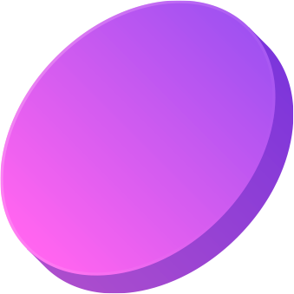


APCSA FINAL PROJECT
CommuniClean
By Wakeland Branz
For Mr. Gates’ NCVPS Class

Slide 2
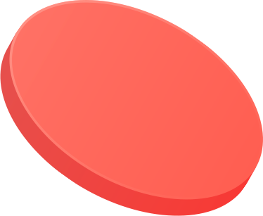

CommuniClean
Welcome to Communiclean, an innovative quiz app designed for high school students who are passionate about the environment and want to make a difference in their communities. CommuniClean aims to educate and engage users by presenting them with a series of multiple-choice questions related to various environmental topics, such as recycling, waste management, and eco-friendly practices.

Slide 3

01
App Features
User guide, main menu, and basic app functionality.

Slide 4
Welcome to CommuniClean
CommuniClean’s user guide is intended for users to be able to understand the basic functionality of the app from the start. It separates the contents of the app into different and well defined sections, each containing simple to understand yet valuable information.
The user guide can be accessed via the link below.
https://docs.google.com/document/d/1XdVFKAtGOfcsp7EP_T0ZYjklyOBbwLcilXL2-SWr-HQ/edit?usp=sharing

Slide 5

Main Menu
CommuniClean’s main menu is simple and to the point. It contains the following:
View User Manual
Begin Playing
Quit
This simplicity makes navigation for the user a breeze.

Slide 6

Quizzes
Quizzes
Storage
Quizzes are loaded from text files into certain classes which handle the prompt and response logic.
Quizzes are stored in a primitive yet optimized text file. Users can learn quiz formats and create quizzes of their own to share. The format can be seen here.

Slide 7
02
Questions
Required Questions for solo developer

Slide 8
My Favorite Part of the Project
Figuring out a storage and parsing method for quizzes was extremely interesting and rewarding.

Slide 9
The Most Frustrating Part of the Project
Planning ahead and creating all of my class objects without being able to immediately test them led to numerous problems once testing began.

Slide 10
If I could do it all over again, I would…
Rather than starting by making class objects and worrying about functionality later, I would build from the ground up with my plans in mind.

Slide 11
If I were giving my awards speech for this project, I would thank...
My mom for valuable advice on UI and UX and my dad for code design advice.

Slide 12
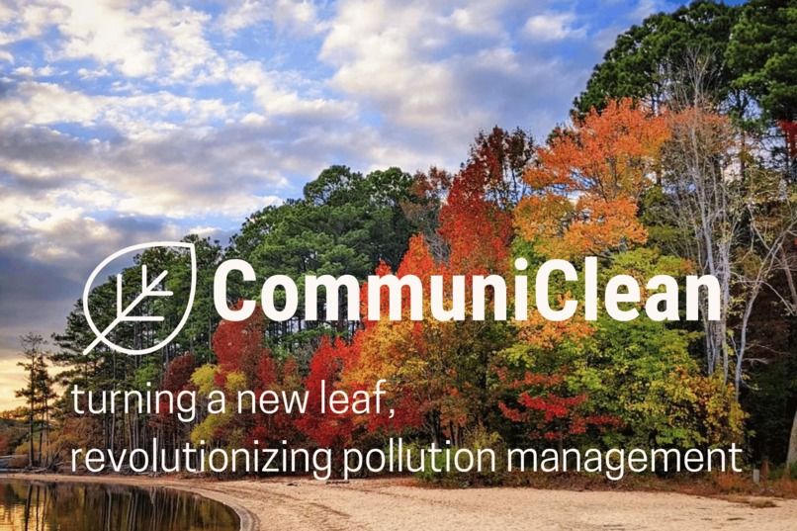

Thank you

